Slide 1
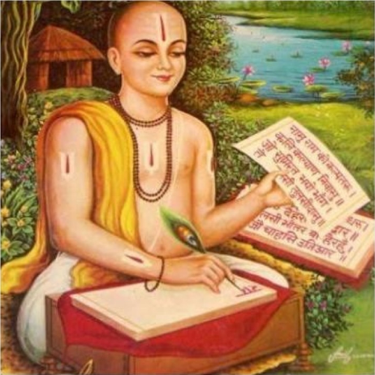
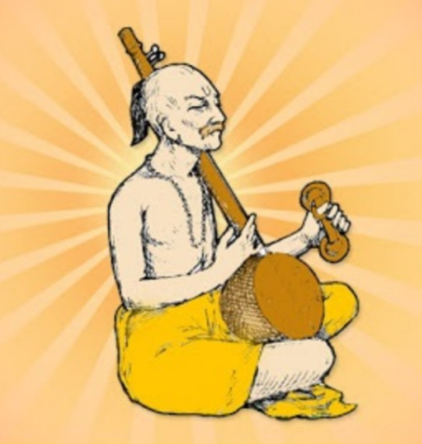
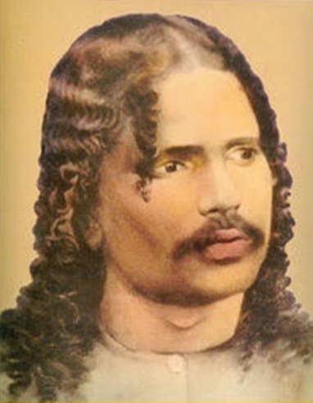
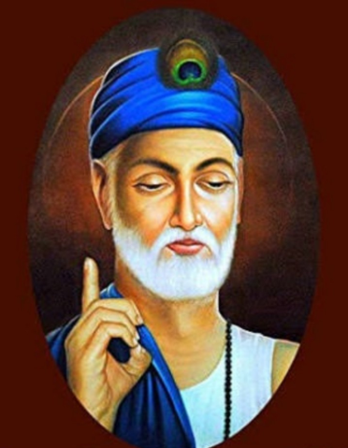
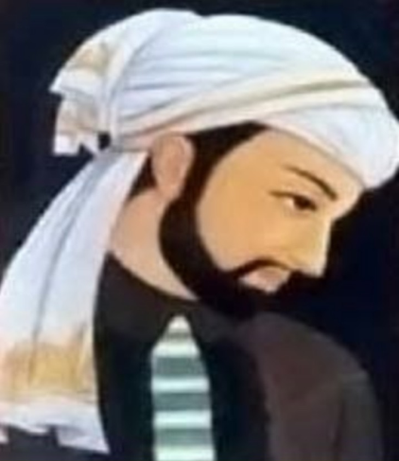
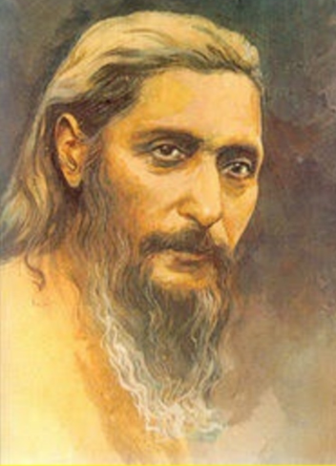
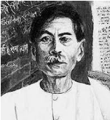
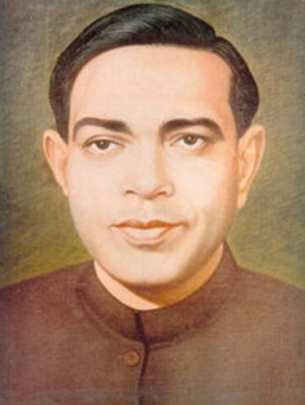
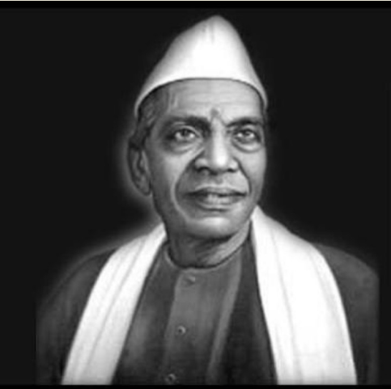
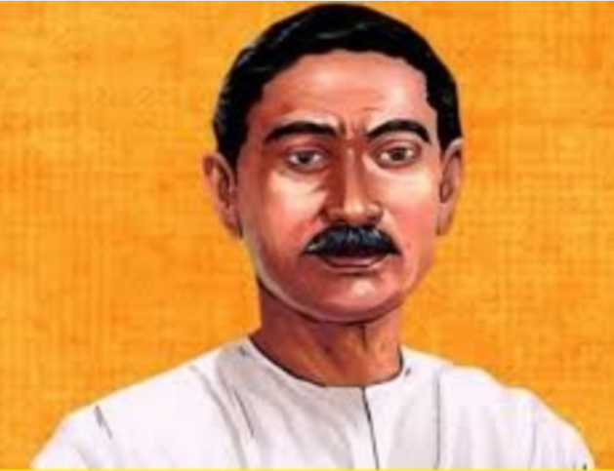
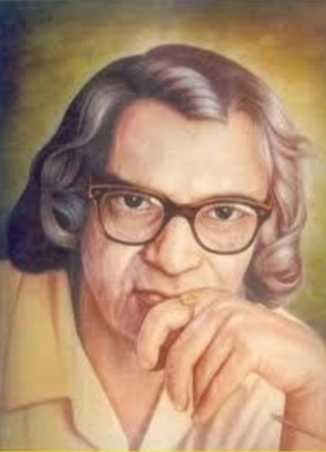
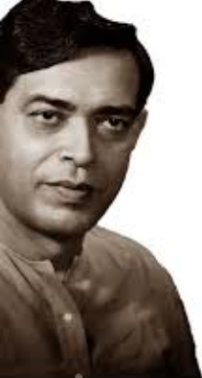
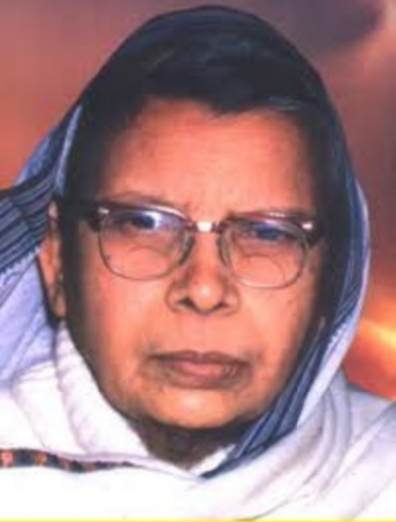
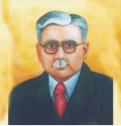
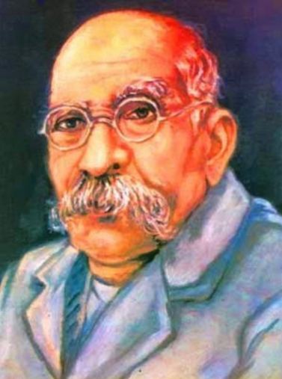
हिन्दी विभाग
अब्दुलबारी मेमोरियल कॉलेज
गोलमुरी जमशेदपुर
कोल्हान विश्वविद्यालय चाईबासा
झारखण्ड -831003

Slide 2
“ हिंदी साहित्य के माध्यम से समाज को संवेदनशील बनाकर सशक्त भारत के निर्माण में अग्रणी भूमिका निभाते हुए वैश्विक स्तर पर हिंदी भाषा को स्थापित करना ”
To establish the importance of Hindi language at the global level through the enriched Hindi literature and to sensitize the society towards the making of strong and powerful India.

Slide 3
Empowering young students to become emotionally as well as financially independent in order to create equality in the society.
महाविद्यालय ds fo|kfFkZ;ksa dks शिक्षा ds ek/;e ls HkkoukRed ,oa vkfFkZd :i ls lcy gksdj lekt esa lekurk dk ntkZ çkIr dj ldsaA
To inspire students from non Hindi backgrounds, to learn and understand the language and in turn establish Hindi as a globally recognized and respected language.
vfgUnh भाषी विद्यार्थियों dks fgUnh i<+us vkSj le>us ds fy, çsfjr djuk rkfd oSf'od Lrj ij fgUnh Hkk"kk dk egRo
LFkkfir gksA

Slide 4
Dr. Ashok Kumar
(Head of the Department)
M.A., Ph.D.
Serving since 1982 -till date
No. of Conference/Workshops attended : 06 Publications : 02
Books Published : 01

Slide 5
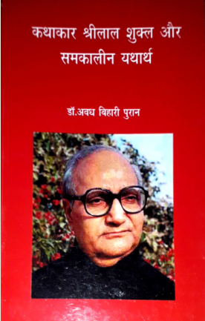
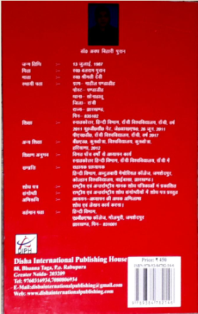
Dr. Awadh Bihari Puran
Assistant Professor
M.A., NET, J.R.F., B.Ed., Ph.D.
Serving since 2017- till date
No. of Conference/Workshops attended : 21
Publications : - 07
Books Published : - 01

Slide 6
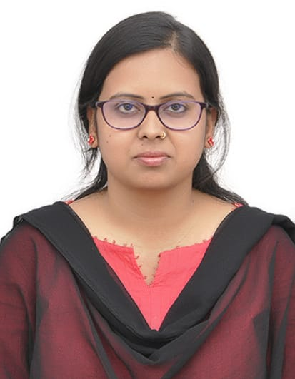
Miss. Kavita Das
Guest Faculty
M.A, NET.
Serving since 2019-till date
Seminar attended : 03

Slide 7
FACULTY STATISTICS Cont.
Name | Qualification | Designation | Years of Experience
Dr. Ashok Kumar | M.A., Ph.D. | Assistant Professor | 37
Dr. Awadh Bihari Puran | M.A.,NET ,JRF, B.Ed. , Ph.D. | Assistant Professor | 07
Kavita Das | M.A., NET | Assistant Professor | 01

Slide 8
 | Weekly Class Distribution
Teacher | I & II (H) | III & IV (H) | V & VI (H) | I & II (G) | III & IV (G) | V & VI (G) | Total
Dr. Ashok Kumar | 06 | 04 | 07 | 00 | 01 | 02 | 20
Dr. Awadh Bihari Puran | 04 | 07 | 05 | 01 | 01 | 00 | 18
Kavita Das | 00 | 04 | 04 | 01 | 01 | 00 | 10
Total | 10 | 15 | 16 | 02 | 03 | 02 | 48

Slide 9
Weekly Class Distribution

Slide 10
FACULTY STATISTICS Cont. Distribution of Honours and General classes
Teacher | Honours (CC) Class | General Elective Classes | DSC Class | Total
Dr. Ashok Kumar | 17 | 00 | 02 | 19
Dr. Awadh Bihari Puran | 15 | 02 | 02 | 19
Kavita Das | 06 | 02 | 03 | 11

Slide 11
Distribution of Honours and General classes

Slide 12
Class lectures
Interaction Seminar
Tutorials Classes
Class Test
Learning through visits to various Libraries and using the College Library
Usage of the World Wide Web to access books. Gaming knowledge about the desired subjects through internet facilities.
Assignments and Research Work and Projects
Curriculum based educational tours
Interactive teaching-learning
process in the classroom structure
Conducting discussions on topics of both National and
d{kk esa O;k[;ku
okn laokn] ifjppkZ
V;wVksfj;y d{kk,¡
Tkkap ijh{kk
iqLrdky; ç;ksx ,oa fofHkUu iqLrdky;ksa dk Hkze.k
baVjusV ç;ksx ,oa vkWuykbu iqLrd v/;;u
y?kq 'kks/k çca/k
ikB~;Øe ls lacaf/kr
{ks=ksa dk Hkze.k
ç'uksÙkjh }kjk d{kk dks
jkspd cukuk

Slide 13
yksdlkfgR;] >kj[k.M dk bfrgkl ,oa laLd`fr
i=dkfjrk tSls & lkaLd`frd] i;ZVu ,oa pyfp= i=dkfjrk
vuqokn foKku
Tkulapkj
n`';&JO; ek/;e
dEI;wVj f'k{kk
vfLerkewyd foe'kZ & ukjh foe'kZ] nfyr foe'kZ] vkfnoklh foe'k⁶Z
Folk literature: History
and Culture of Jharkhand
Journalism: Culture, Tourism, Film studies, Script writing etc.
Translation studies
Electronic Media Communication
Computer literacy
Literary Critique: Feminist Writing, Dalit Writing, Tribal Writing
Research methodology

Slide 14
Setting Question papers
Evaluation work
Member of press
committee
Organizing Seminars and Workshops
Charting out a teaching
plan
Examination conduction
Invigilation work
ç'u&i= fuekZ.k
ewY;kadu dk;Z
çsl dfefV ds lnL;
lsfeukj ,oa dk;Z'kkyk dk vk;kstu
vkfFkZd :i ls fiNM++h Nk=kvksa dh lgk;rk
Vhfpax Iyku cukuk
e/; l= ijh{kk
oh{kd dk;Z

Slide 15
f'kf{kdksa ds }kjk foHkkxh; iqLrdky; cukdj Nk=kvksa dks iqLrd miyC/k djkukA
detksj Nk=kvksa fy, fo'ks"k
d{kk dk vk;kstu
vfrfFk oDrk }kjk O;k[;kuekyk
Nk=kvksa ds fy, Doht ,oa
okn&fookn çfr;ksfxrk dk vk;kstu
Question bank dk fuekZ.k
Nk=kvksa ds O;fDrRo fodkl ds fy, fofHkUu dk;ZØeksa dk vk;kstu
fofHkUu dk;ZØeksa esa
Uplifting students from economically weaker backgrounds
Created a Departmental Library through donation of books by faculty members to aid in students’ leaning process
Remedial Classes for students who cannot match up with the class curriculum.
Organizing Guest Lectures by
specialists of respective fields
Conducting curriculum based quizzes and discussions to make the learning process interactive
Organizing workshops for
personality and confidence building
Anchoring in programmes both by
College and the University.
Serving as Judges for various competitions.
eap&lapkyu
fu.kkZ;d dk;Z

Slide 16
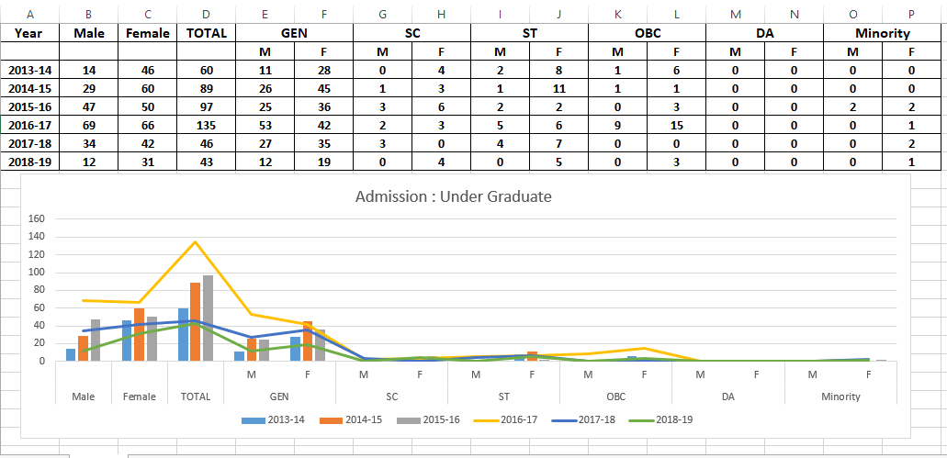
Admission : Under Graduate

Slide 17
Students Success

Slide 18
STUDENT SUCESS RATE CONT....

Slide 19
Having a department full of students and faculty who are dedicated
f'k{kd ,oa fo|kFkhZ egkfo|ky;
ds çfr lefiZr gSaA
f'k{kd ,oa fo|kfFkZ;ksa ds chp e/kqj laca/k
f'k{kd&f'k{kd ds chp fo'oluh; laca/k
towards the excellence of the College
Cordial and healthy relationship
between faculty and students
A faithful bond between faculty
members with a common goal of betterment of the department and the college.
Unbiased feedback from students
Anonymous suggestion box for the improvement of departmental activities
Having strong Alumni in various
f'k{kdksa ds laca/k esa fo|kfFkZ;ksa }kjk yh tkus okyh çfrfØ;k
lq>ko isVh ds ek/;e ls foHkkx dks csgrj cukus ds fy, tkus okys lq>ko
fofHkUu {ks=ksa esa çfrLFkkfir
iwoZ fo|kfFkZ;ksa dk orZeku विद्यार्थियों के भविष्य निर्माण में महत्वपूर्ण सहयोग
fields of life, who are dedicated in
assisting present students to excel in
their lives

Slide 20
Students from weaker sections of the society lack family support towards education and learning
Students from economically weaker families work part time Job to which they find it difficult to solely focus on education
Marriage in the main Couse for female students as they quite their studies in the middle of the session.
Ikkfjokfjd lg;ksx ds vkHkko esa Nk=&Nk=kvksa dks mPp f’k{kk ls tqM+us esa dfBukbZ
vkfFkZd raxh >sy jgh dkedkth Nk=&Nk=kvksa dk i<+kbZ ij dsfUær u gks ikuk
छात्राओं का बीच में पढाई छोड़ना महत्वपूर्ण कारण-विवाह

Slide 21
Inspiring students towards entrepreneurial ventures
Enthusing them towards inculcating reading habits
Creating awareness about the less discussed diseases.
Creating a secular environment amongst students from various religious and social backgrounds.
Establishing a Friendly Harmony among the students so that they may inspire and motivate can others.
To make the students aware about their rights and duties
Lojkstxkj ds fy, çsfjr djuk
iqLrd iBu ds fy, çsfjr djuk
fofHkUu chekfj;ksa ds laca/k esa Nk=&Nk=kvksa dks tkudkjh nsuk
fofHkUu oxZ] leqnk;] tkfr ls lacaf/kr Nk=&Nk=vksa ds chp ln~Hkkouk mRiUu djuk
महाविद्यालय में अध्ययनरत विद्यार्थियों के बीच बंधुत्व भाव उतपन्न करना जिससे की वे एक- दूसरे की उन्नति में सहायक बने
विद्यार्थियों को अपने अधिकार और कर्तव्य के बारे में सम्पूर्ण जानकारी प्रदान करना

Slide 22
Bridging the gap between
students
fiNM+s {ks= dh Nk=&Nk=kvksa dks v/;;u ds fy, çsfjr djuk
çfrHkkoku Nk=&Nk=k,¡ tks vkfFkZd foiUurk ,oa fookg ds dkj.k i<+kbZ NksM+ nsrh gS] mUgsa iqu% i<+kbZ ls tksM+uk
शिक्षा एवं आर्थिक रूप से स्वावलम्बी बनाने हेतु अभिभावकों को प्रेरित करना
from tribal
and much
backgrounds
required higher education.
Motivating students to
complete their education
and not leave their degrees incomplete due to forced marriages or financial crisis.
Encouraging guardians and parents to support their childrens for higher education and financial independence.

Slide 23
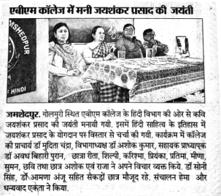

Slide 24
14

Slide 25
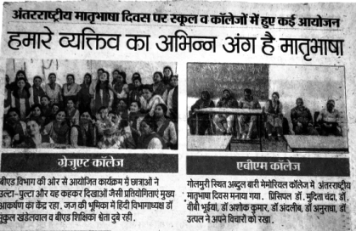

Slide 26
Dept of
Journalism & Mass Communict
aion, ₁₅
Jamshedpu
r Womens' College,
Jamshedpu
r

Slide 27
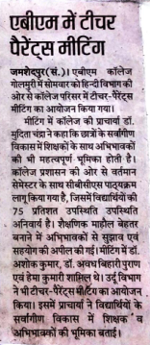

Slide 28
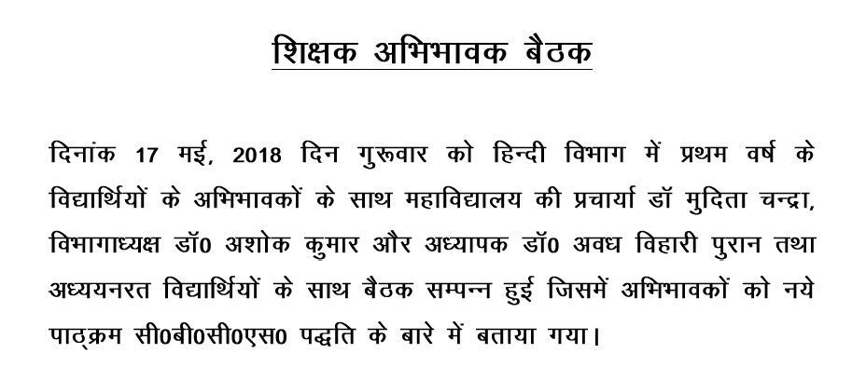
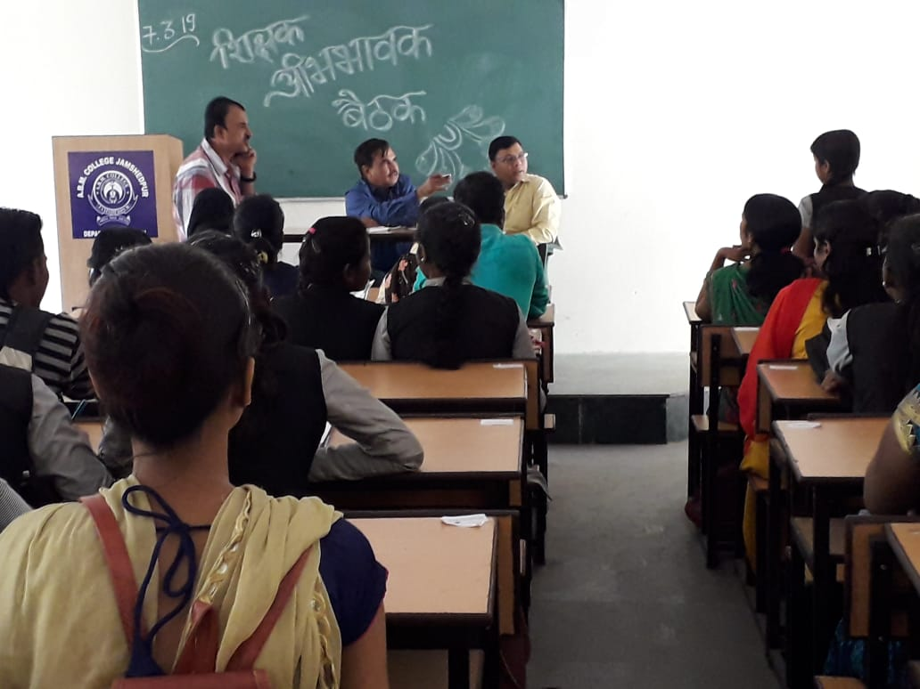
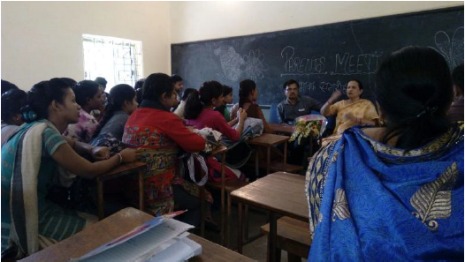
16

Slide 29
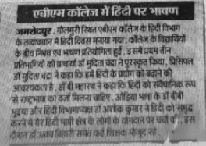
16

Slide 30
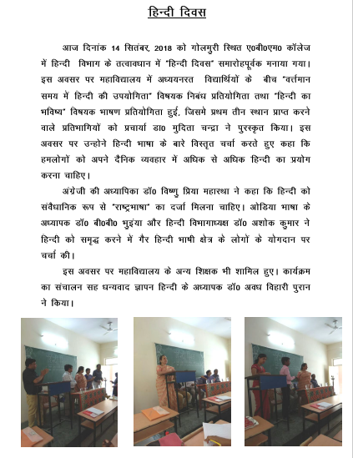
Dept of Journalism & Mass Communictaion, Ja
Womens' College, Jamshedpur
mshedpur ₁₇

Slide 31
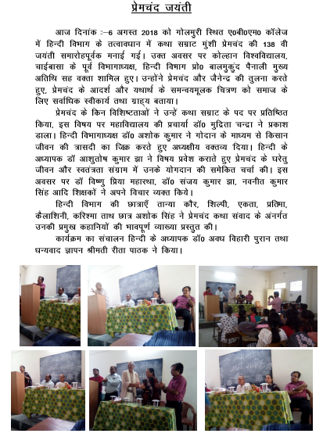
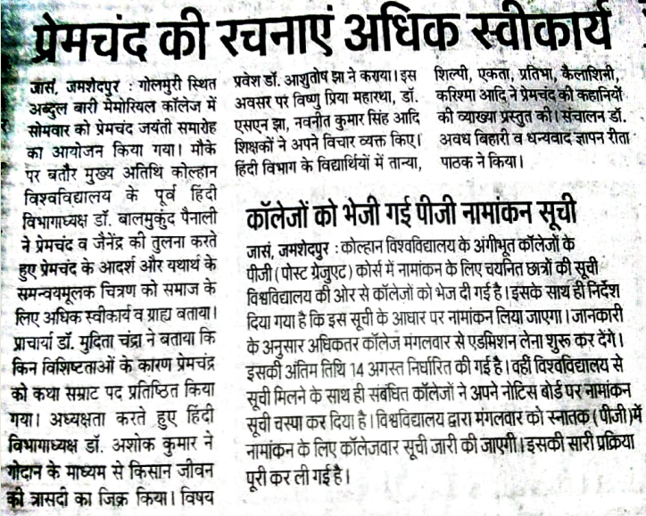
Dept of Journalism & Mass Co
Womens' Colleg
mmunictaion, Jamshedpur
e, Jamshedpur ¹⁸

Slide 32
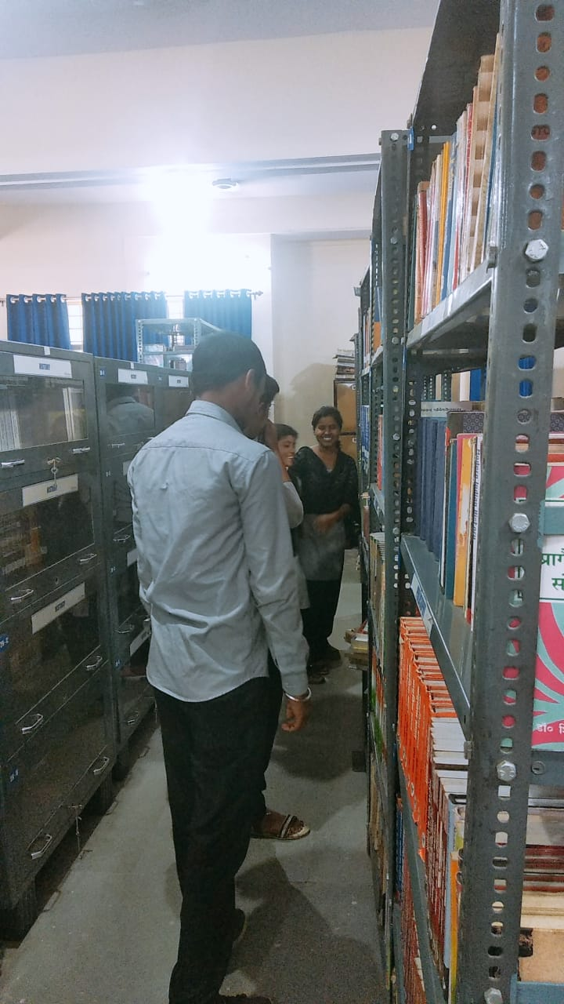
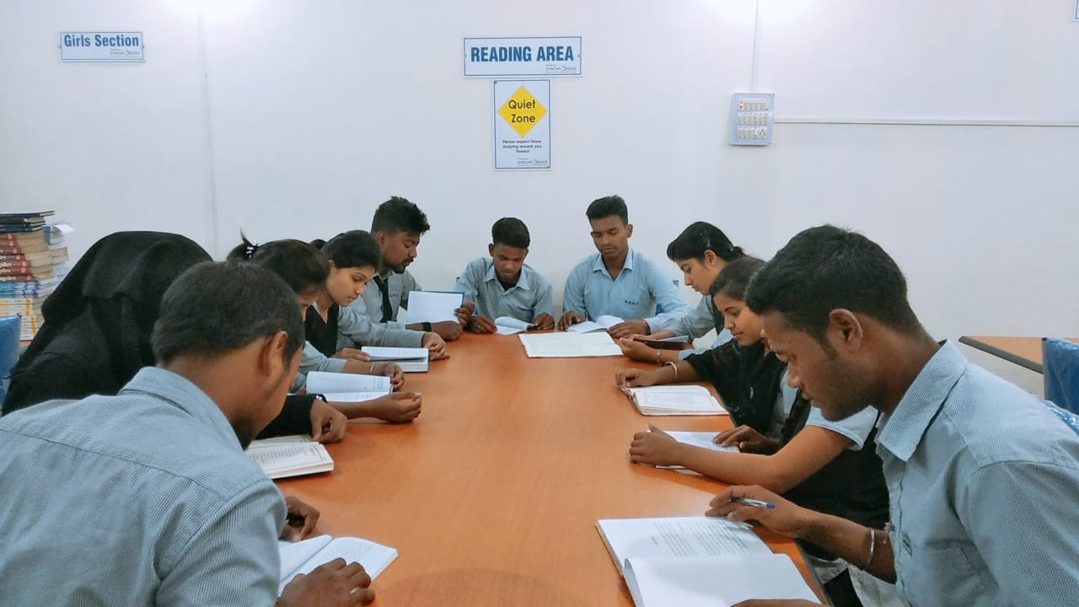
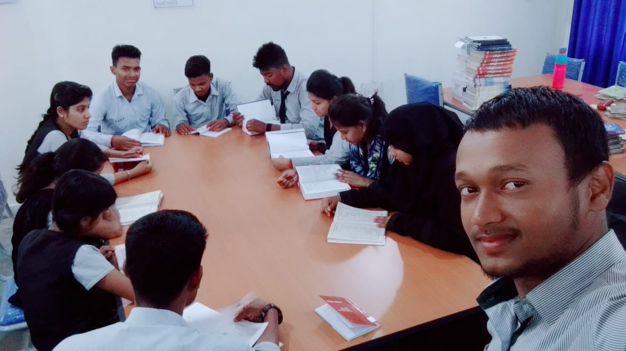
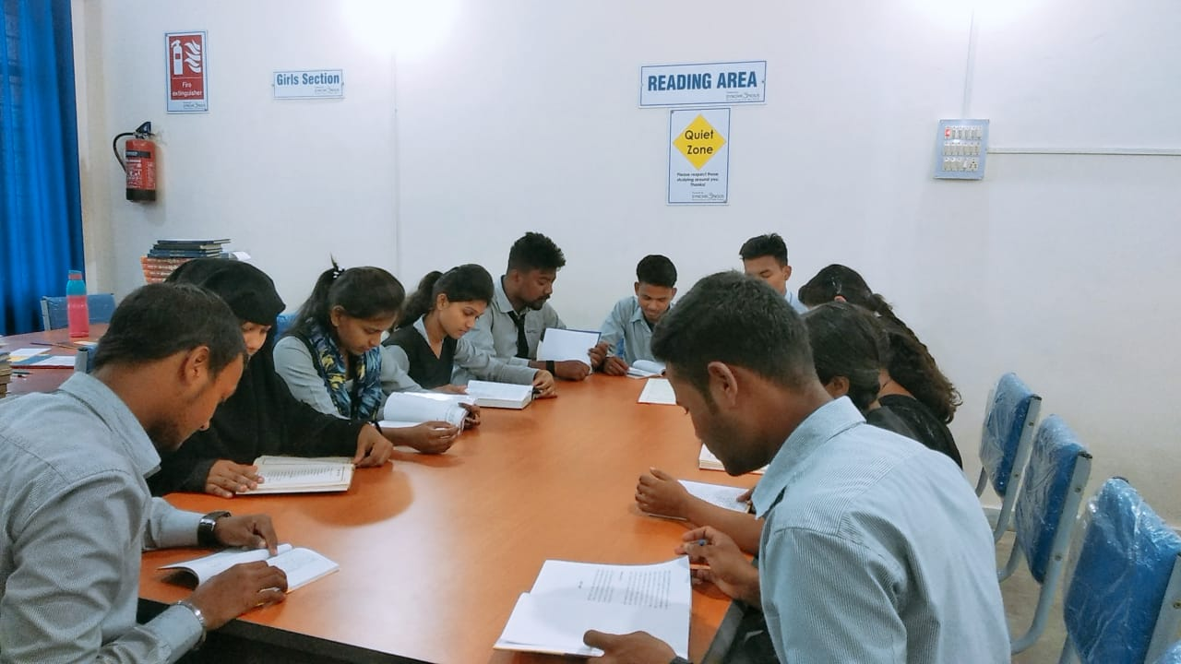
Library Visit

Slide 33
MEMBERSHIP OF FACULTIES IN THE COLLEGE
Dr. Ashok kumar
Coordinator: NSS
Coordinator: Press Committee
Dr. Awadh Bihari Puran
Member: Press Committee
Member: Student Grievance Cell
Member: Cleaning Committee
Member: ST/SC cell

Slide 34
/kU;okn!

